Slide 1
Korean TV Shows & Movie Cultural Literature Review
Khai Phan Thanh
Korean Language Skill (LGE923-N1A)
Lee Won Hee 선생님

Slide 2
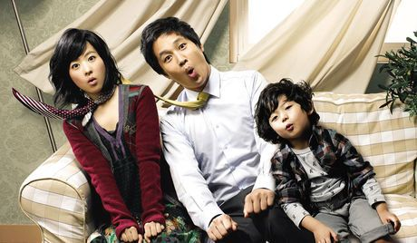
스캔들 메이커
Scandal Maker

Slide 3
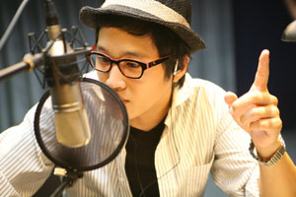
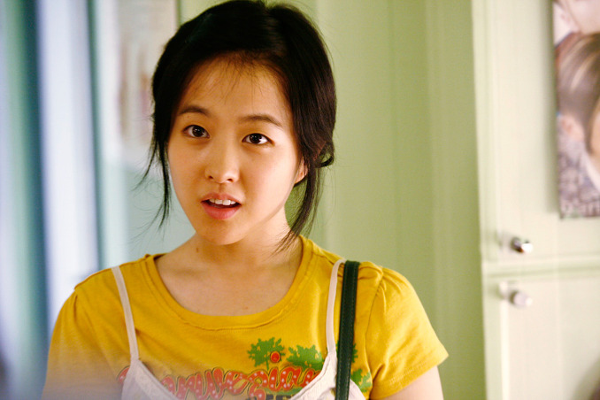
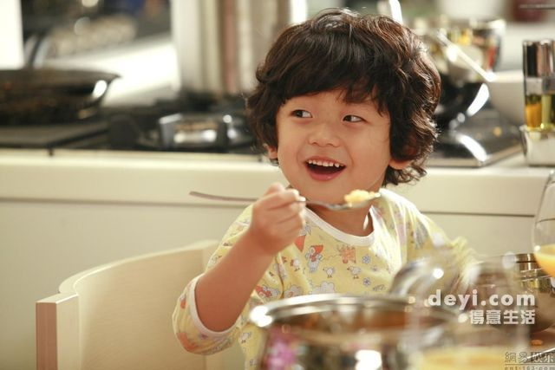
배우
이름: 차 태현 이름: 박 보영 이름: 왕 석현
영화 이름: 남 혜수 영화 이름: 황 정남 영화 이름: 황 기동
직업: 라디오 방송사 직업: 싱글맘 직업: 학생

Slide 4
처음에
황 정남 called in to 남 혜수’s radio station to share her story about her father
남 혜수 gave her some advice and encourage her to find the father, turns out, 남 혜수 is 황 정남’s dad
He afraid the public will know his bad story which impact his reputation so he agreed to take responsible for 황 정남 and the grandson (황 기동)

Slide 5

영화의 의미
Family is number-one and there is nothing worth more 가족이 최고이에요
Notes:
https://www.youtube.com/watch?v=bdUYemBuCbY&t=5590s

Slide 6
영화의 의미
https://www.youtube.com/watch?v=bdUYemBuCbY&t=5590s

Slide 7


가족 문제

Slide 8
가족 문제
https://www.youtube.com/watch?v=bdUYemBuCbY&t=4410s

Slide 9
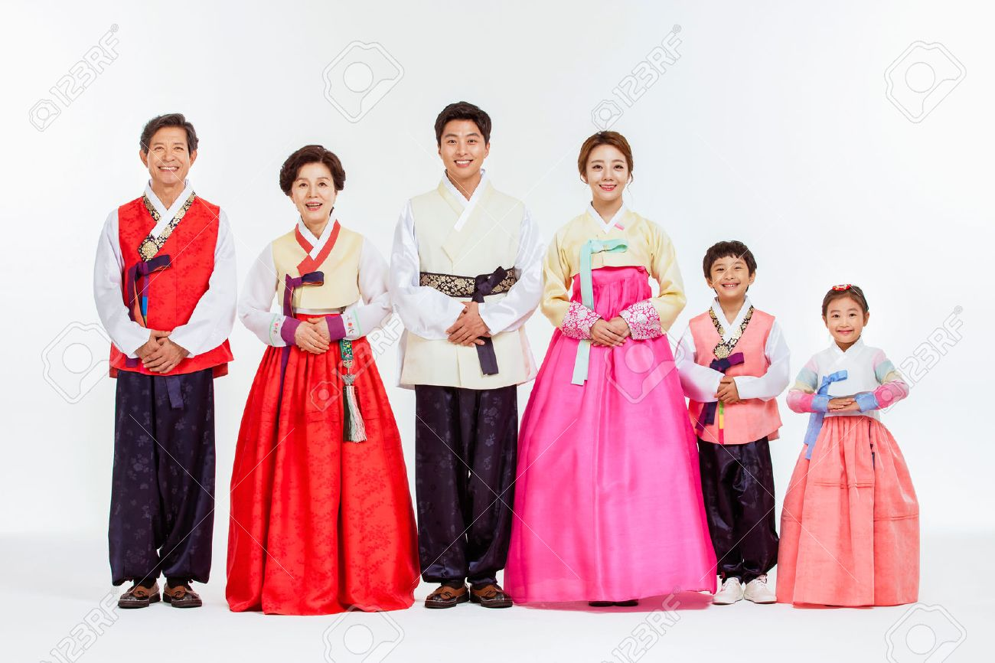
한국 가족 문화와 전통

Slide 10


질문있어요?

Slide 11
References
Image
https://alualuna.wordpress.com/2011/11/08/scandal-makers/
http://asianwiki.com/Scandal_Makers
https://www.viki.com/movies/36072c-scandal-makers
https://www.lovehkfilm.com/panasia/scandal_makers.html
https://m.post.naver.com/viewer/postView.nhn?volumeNo=17654551&memberNo=32011753
https://www.gettyimages.ca/illustrations/family-fighting-cartoon?sort=best&mediatype=illustration&family=creative&phrase=family%20fighting%20cartoon
https://medium.com/other-opinions/family-politics-and-society-fighting-to-live-with-each-other-718a27a661ab
https://www.123rf.com/photo_70604596_portrait-of-asian-three-generation-family-in-hanbok-korean-traditional-clothes.html
Information
https://alualuna.wordpress.com/2011/11/08/scandal-makers/
https://www.youtube.com/watch?v=bdUYemBuCbY
https://www.hollywoodreporter.com/review/scandal-makers-film-review-93181

